Slide 1
C66x KeyStone Training HyperLink
Notes:
1
NEW

Slide 2
Agenda
Overview
Address Translation
Configuration
Performance
Example

Slide 3
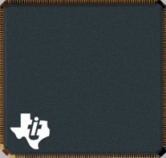
Overview: What is HyperLink?
High-speed chip-to-chip interface that connects…
Keystone devices to each other, or
Keystone device to an FPGA
Key Features and Advantages
High-speed -- 4 lanes at 12.5 Gbps/lane
Low power -- 50% less than similar serial interfaces
Low latency, low protocol overhead and low pin count
Industry-standard SerDes
KeyStone
HyperLink
KeyStone
KeyStone
HyperLink
KeyStone
C6678
C6678 Remote
TCI6614
C6678
1 Cortex A8
4 DSP cores
4 – 8 DSP cores
Notes:
3

Slide 4
Overview: Example Use-Case with 6678
Device A sends packet frame to Device B for processing and receives result; Both transactions via HyperLink.
Enables scalable solutions with access to remote CorePacs to expand processing capability. Device B acts as codec accelerator in this case.
Reduce system power consumption by allowing users to disable I/O and peripherals on remote device.
Device A: all peripherals active
Device B: only HyperLink active

Slide 5
Overview: HyperLink External Interfaces
Data Signals SerDes-based
1-lane or 4-lane mode, with 12.5 Gbps data rate per lane
Control Signals LVCMOS-based
Flow control (FL) and Power Management (PM)
Auto managed by HyperLink after initial, one-time configuration by user
FL managed on per-direction basis; RX sends throttle to TX
PM dynamically managed per-lane, per-direction based on traffic

Slide 6
Overview: HyperLink and TeraNet
Memory Subsystem
Application-Specific
C66x CorePacs, EDMA & peripherals are interconnected via TeraNet switch fabric
HyperLink seamlessly extends TeraNet from one device to another
Enables read/write transactions, as well as relaying & generation of interrupts between devices
64-Bit
MSM
Coprocessors
DDR3 EMIF
SRAM
MSMC
Debug & Trace
Boot ROM
Semaphore
C66x™
Power
CorePac
Management
PLL
L1
L1
x3
P-Cache
D-Cache
EDMA
L2 Cache
x3
1 to 8 Cores @ up to 1.25 GHz
HyperLink
TeraNet
Multicore Navigator
Queue
Packet
Manager
DMA
x2
-
O
x4
t
s
T
n
/
e
h
r
o
I
n
I
i
c
e
C
R
P
t
c
r
t
h
e
a
i
O
Security
h
A
c
f
e
i
2
I
S
i
c
t
I
i
c
I
h
w
Accelerator
C
U
l
e
R
t
O
P
p
p
t
S
i
p
S
S
E
w
A
S
Packet
I
Accelerator
I
M
x2
G
S
Network Coprocessor
Notes:
6
Talking Points
In Keystone devices, we see that C66x CorePacs, EDMA3 transfer controllers, and system peripherals are interconnected through TeraNet
TeraNet is a non-blocking switch fabric that enables fast and contention-free internal data movement, and concurrent data transfers between master peripherals and slave peripherals.
HyperLink essentially extends TeraNet from one device to another
It not only supports read/write transactions from one device to another but also ports events and interrupts across devices

Slide 7
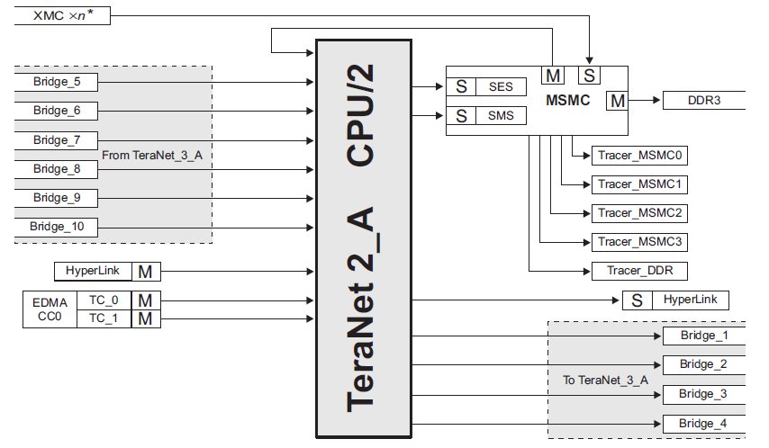
Overview: TeraNet Connections
C66x CorePacs, EDMA & peripherals classified as master or slave
Master initiates read/write transfers. Slave relies on master
HyperLink master and slave ports connected via TeraNet 2A
Notes:
256-bit TeraNet, 600 MHz CPU/2

Slide 8
Overview: HyperLink Interrupts
64 interrupt inputs to HyperLink module
0-31 from Chip Interrupt Controller (CIC) # 3
CIC3 events include GPIO, Trace, & Software-Triggered
32-63 from Queue manager (QMSS) pend event
I_0
If intlocal = 0, then send interrupt packet
to remote device
I_0
If intlocal = 0 send interrupt packet
to remote device
Local Device’s HyperLink
Remote Device’s HyperLink
I_1
I_1
I_63
If intlocal = 1
vusr_ INT0
I_63
If intlocal = 1
vusr_ INT0
Interrupt Status Register (32 bits)
Interrupt Status Register (32 bits)
If int2cfg = 1
If int2cfg = 1
Received Interrupt Packet
Received Interrupt Packet
If int2cfg = 0, write to CIC
If int2cfg = 0, write to CIC
Notes:
8

Slide 9
Overview: HyperLink Interrupts
CIC0
Input Events to Core 0, 1, 2 & 3
Event # 111
vusr_INT_0
CIC1
Input Events to Core 4, 5, 6 & 7
Event # 111
vusr_INT_0
CIC2
Input Event to EDMA3 CC1 & CC2
CIC3
Input Events to HyperLink & EDMA3 CC0
Event # 44
32 Input Events from CIC3
vusr_INT_0
HyperLink
32 Input Events from Qpend
Notes:
9

Slide 10
Overview: Packet-based Protocol
HyperLink offers a packet-based transfer protocol that supports multiple outstanding read, write and interrupt transactions
Users can use HyperLink to:
Write to remote device memory
Read from remote device memory
Generate events / interrupt in the remote device
Read/Write transactions with 4 packet types
Write Request / Data Packet
Write Response Packet (optional)
Read Request Packet
Read Response Data Packet
Interrupt Packet passes event to remote side
16 byte packet header for 64 byte payload, and 8b/9b encoding
Notes:
Write response packet – acknowledgement on write.
Most masters send data in terms of burst – burst width is 64 bytes for most masters. Table in 6678 data manual – for burst size of masters

Slide 11
Overview: Typical Configuration Flow
Application typically follows this flow to enable & configure HyperLink:
PLL, Power and SerDes
Setup PLL
Enable power domain for HyperLink
Configure SerDes
Confirm that power is enabled
Register Configurations
Enable HyperLink via HyperLink Control Register (base + 0x4)
Once link is up, both devices can see each other’s registers. Here there’s a choice: device configures own registers; or one master programs registers for both devices; or direction-based
Register configuration involves specifying address translation scheme on Tx & Rx side, and any event/interrupt configuration
Notes:
Two ways this configuration can be achieved. One way is using the Chip-Support Library (CSL) and the other way is using the HyperLink LLD

Slide 12
Agenda
Overview
Address Translation
Configuration
Performance
Example

Slide 13
Address Translation: Motivation
Device A (Tx) can view max. 256MB of Device B (Rx) memory**.
Tx side: HyperLink memory space is 0x4000_0000 to 0x4FFF_FFFF
Rx side: HyperLink memory space device dependent, but typically somewhere in the 0x0000_0000 to 0xFFFF_FFFF address range For example: DDR 0x8000_0000 to 0x8FFF_FFFF
Require mechanism to convert local (Tx) address to remote (Rx) address
Address translation occurs on both Tx and Rx side
Device B
Device A
** For each core
Notes:
Example: 0x4000_0000, look at address 0x8000_0000

Slide 14
Address Translation: Write Example
Local Device HyperLink: Transmit (Tx)
Slave receives write transaction
Overlay control info. onto address
Write command to outbound FIFO
Encode, serialize & transmit packet to remote device
HyperLink Slave Port
Address Translation
Outbound Cmd. FIFO
TxSM
PLS
SerDes
Remote Device HyperLink: Receive (Rx)
Generate new memory mapped address and control info.
Store received packet to inbound FIFO
Initiate write operation
Receive, de-serialize and decode packet
HyperLink Master Port
Address Translation
Inbound Cmd. FIFO
RxSM
PLS
SerDes

Slide 15
Address Translation: Considerations
Local HyperLink address range is 0x4000_0000 to 0x4FFF_FFFF, i.e. MSB always starts with 0x4. Implies, 28 bits is the max. required to represent address offset.
HyperLink supports up to 64 different memory reg./segments at Rx
Segment size – Minimum 512 bytes, Maximum 256 MB
Segments have to be aligned on 64 KB (0x0001_0000) boundary.
Implies, least-significant 16 bits of segment base address is always 0.

Slide 16
Address Translation: Segmentation
Number of bits used to represent address offset and number of bits used to choose segment depend on size of largest segment.
Largest Segment Size in Bytes (Power of 2) | Number of Bits for Address Offset | Maximum Number of Segments | Number of Bits to Choose Segment
256 MB 0x0FFF_FFFF | 28 | 1 = 2^0 | 0
128 MB 0x07FF_FFFF | 27 | 2 = 2^1 | 1
8 MB 0x007F_FFFF | 23 | 32 = 2^5 | 5
4 MB 0x003F_FFFF | 22 | 64 = 2^6 | 6
2 MB 0x001F_FFFF | 21 | 64 = 2^6 | 6
16 KB 0x0000_3FFF | 14 | 64 = 2^6 | 6

Slide 17
Address Translation: Considerations
TX side does not have to know the internal architecture of the RX side
The system was designed to be generic enough, so it will support future version of device architecture (for example, larger window)
Result – Address translation is more generic and thus a little complex. This presentation will try to simplify it
Notes:
For this presentation we ignore the security bit to avoid adding more parameters, and ensure that the primary aspects are understood. Once you are familiar with this presentation, you can look at the HyperLink User Guide to understand the security bit overlay

Slide 18
Address Translation: Overlay
Overlay means using the same bit for more than one purpose
Result – Look up tables might require duplication
Example – if index to look up table shares a bit with other value (security bit) the table must be duplicated
Value in the table in index 0xxx must be the same as the value in 1xxx
Notes:
For this presentation we ignore the security bit to avoid adding more parameters, and ensure that the primary aspects are understood. Once you are familiar with this presentation, you can look at the HyperLink User Guide to understand the security bit overlay

Slide 19
Address Translation: Tx Side Registers
Tx Address Overlay Control Register
User configures PrivID / Security bit overlay in this register
Register is at address HyperLinkCfgBase + 0x1c. For 6678 that is 0x2140_001c
If using HyperLink LLD, hyplnkTXAddrOvlyReg_s represents this register
31 | 20 | 19 | 16 | 15 | 12 | 11 | 8 | 7 | 4 | 3 | 0
Reserved |  | txsecovl |  | Reserved |  | txprividovl |  | Reserved |  | txigmask
R |  | R/W |  | R |  | R/W |  | R |  | R/W

Slide 20
Address Translation: Tx Side Registers
Register Field | Purpose | Bits | Range
txigmask | Selects mask that is logically ANDed to incoming address. Determines what address bits will be sent to remote side. Examples: 0 → mask = 0x0001_FFFF, 10 → mask = 0x07FF_FFFF | 4 | Mask varies from 0x 01ffff (value 0) to 0xffffffff (value 15)
txprividovl | Selects where PrivID will be placed in outgoing address Example: 12 → TxAddress [31-28] = PrivID [3-0] | 4 | 4 bits (from 17-20 to 28-31) 3 bits (29-31) 2 its (30-31) 1 bit (31) 0 – no privID
txsecovl | Selects where Security Bit is placed in outgoing address | 4 | No security bit 1 bit (from bit 17 to 31)
Remember the Overlays!!!

Slide 21
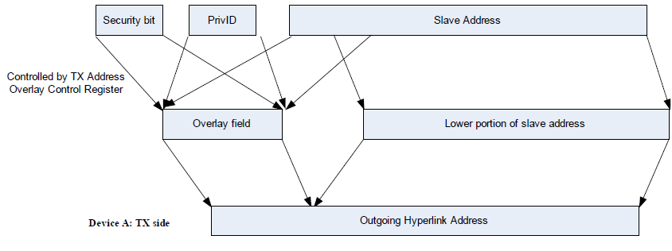
Address Translation: Tx Side
Objective: Overlay control information onto address field
Control information consists of PrivID index and Security bit
PrivID index represents which master the request is coming from
Security bit represents whether the security feature is on or off
PrivID index is 4 bits. PrivID (on RX side) value is usually 0xD if request from core; 0xE if from other master
Notes:
For this presentation we ignore the security bit to avoid adding more parameters, and ensure that the primary aspects are understood. Once you are familiar with this presentation, you can look at the HyperLink User Guide to understand the security bit overlay

Slide 22
Address Translation: Rx Side Registers
Rx Address Selector Control Register
Register is at address HyperLinkCfgBase + 0x2c. For 6678, that is 0x2140_002c
If using HyperLink LLD, hyplnkRXAddrSelReg_s represents this register
Rx Address Selector Control Register (more details in HyperLink User Guide)
31 | 26 | 25 | 24 | 23 | 20 | 19 | 16 | 15 | 12 | 11 | 8 | 7 | 4 | 3 | 0
Reserved |  | rxsechi | rxseclo | Reserved |  | rxsecsel |  | Reserved |  | rxprividsel |  | Reserved |  | rxsegsel
R |  | R/W | R/W | R |  | R/W |  | R |  | R/W |  | R |  | R/W

Slide 23
Address Translation: Rx Side Registers
Register Field | Purpose | Bits | Range
Rxsechi | Deals with security signal | 1 | 0-1
rxseclo | Deals with security signal | 1 | 0-1
rxsecsel | The overlay location of the security bit | 4 | 16-31
rxsegsel | Selects which bits of the incoming RxAddress to use as an index to lookup segment length and size from the Segment LUT. Depends on max. segment size. Example: rxsegsel=6 → use RxAddress [27-22] as index to LUT and the offset mask is 3fffff (22 bits offset address) | 4 | 6 bits (17-22 to 26-31) 5 bits (27-31) 4 bits (28-31) 3 bits (29-31) 2 bits (30-31) 1 bits (31) 0 bits
rxprividsel | Selects which bits of the incoming RxAddress to use as PrivID index PrivID index is used as the row # to lookup PrivID value from LUT Example: rxprividsel=12 → RxAddress [31-28] as index to LUT | 4 | 4 bits (17-20 to 28-31) 3 bits (29-31) 2 bits (30-31) 1 bit (31) 0 bits
Remember the Overlays!!!

Slide 24
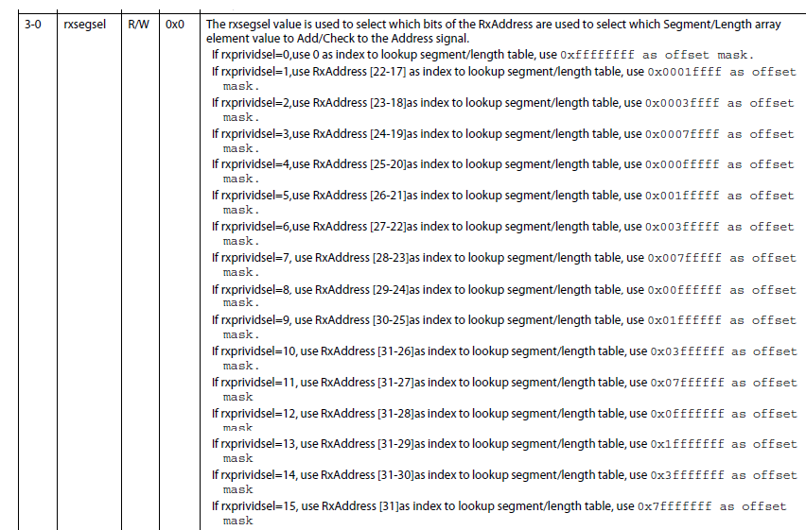
From the User’s Guide - rxsegsel

Slide 25
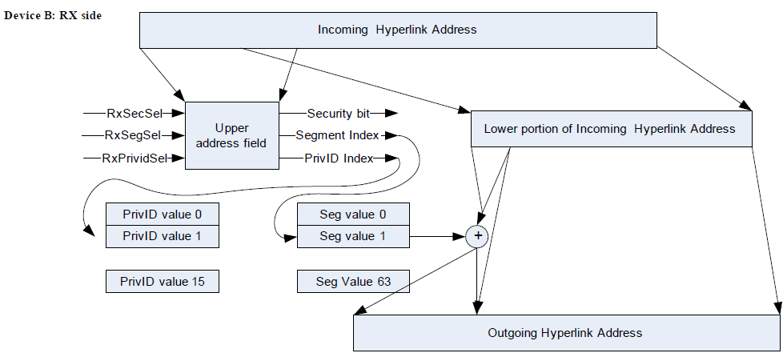
Address Translation: Rx Side
Objective: Regenerate address mapped to remote memory space, along with Security bit and PrivID from incoming address, based on values in Rx Address Selector Control Register and LUTs
PrivID LUT
Segment LUT

Slide 26
Address Translation: Rx Side LUTs
SEGMENT LUT
hyplnkRXSegTbl_t [numSegments], with numSegments<=64 & power of 2
Each entry in the LUT consists of:
16-bit rxSegVal, the upper 16-bits of each segment’s base address
5-bit rxLenVal, which represents the segment size as per table on the right and a mask
rxLenVal | Size
0 – 7 | 0
8 | 512B
. . . | . . .
21 | 4MB
. . . | . . .
27 | 256MB
Example Scenario
4 segments, 4 MB each, with base addresses as 0x8000_0000, 0x8200_0000, 0x8400_0000 and 0x8600_0000
then Segment LUT will be:
Segment # | rxSegVal | rxLenVal
0 | 0x8000 | 21
1 | 0x8200 | 21
2 | 0x8400 | 21
3 | 0x8600 | 21
Notes:
As mentioned earlier, and as can be seen in the rxLenVal table, see smallest segment size is 512Bytes

Slide 27
Address Translation: Rx Side LUTs
Privilege ID LUT
hyplnkRXPrivTbl_t [numPriv], with numPriv <=16 & power of 2
Each entry in the LUT consists of:
A value between 0-15 that represent the privilege ID of the master
Common use, value D if comes from any core, E if from any other master
Notes:
As mentioned earlier, and as can be seen in the rxLenVal table, see smallest segment size is 512Bytes

Slide 28
Examples
We present several examples that can be used in KeyStone with the following limitations:
No security bit
The privilege ID index will be in the 4 MSB of the address, bits 28-31
We will cover the RX overlay registers, and the different LUT
On the TX side, we will always send the upper 28 bits, so that the value of txsecovl = 0, txprividovl = 12 (bits 28-31) and txigmask = 11 (0x0fffffff)
31 | 20 | 19 | 16 | 15 | 12 | 11 | 8 | 7 | 4 | 3 | 0
Reserved |  | txsecovl |  | Reserved |  | txprividovl |  | Reserved |  | txigmask
000000000000 |  | 0 |  | 0000 |  | 1100 |  | 0000 |  | 1011

Slide 29
RX side, privilege LUT
Index | Value
0 | D = 1101
1 | D = 1101
2 | D = 1101
3 | D = 1101
4 | D = 1101
5 | D = 1101
6 | D = 1101
7 | D = 1101
8 | E=1110
9 | E=1110
10 | E=1110
11 | E=1110
12 | E=1110
13 | E=1110
14 | E=1110
15 | E=1110
Since all remote cores will have PrivID of D, and other masters have ID of E, and there are 4 bits to express the PrivID index, the look-up table for privID is the following:
Notes:
As mentioned earlier, and as can be seen in the rxLenVal table, see smallest segment size is 512Bytes

Slide 30
Address Translation: Example 1
Problem Statement:
Build the Segment LUT for the following scenario
Remote DDR 0x8000_0000 - 0x8FFF_FFFF as one 256MB segment that can be access by all the 16 masters on the local side
Solution
Because the segment size is 256M, the offset mask must be 0x0fff ffff and thus rxsegsel = 12, index to lookup table is bits 28-31 and 0x0fffffff is the mask
It looks like the table should have only one row
No security bit
Privilege index can be any number from 0 to 15. In this example, (and all examples in the presentation) we use rxprividsel = 12, that is bits 28-31
Notice the overlay of the master on the index? It means that the segment index can be any number between 0 and 15, so we must repeat the first line 16 times.
rxLenVal | Size
0 – 7 | 0
8 | 512B
. . . | . . .
21 | 4MB
. . . | . . .
27 | 256MB
Segment # | rxSegVal | rxLenVal
0 | 0x8000 | 27

Slide 31
Address Translation: Example 1(2)
Segment # | rxSegVal | rxLenVal
0 | 0x8000 | 237
1 | 0x8000 | 27
2 | 0x8000 | 27
3 | 0x8000 | 27
4 | 0x8000 | 27
5 | 0x8000 | 27
6 | 0x8000 | 27
7 | 0x8000 | 27
Segment # | rxSegVal | rxLenVal
8 | 0x8000 | 237
9 | 0x8000 | 27
10 | 0x8000 | 27
11 | 0x8000 | 27
12 | 0x8000 | 27
13 | 0x8000 | 27
14 | 0x8000 | 27
15 | 0x8000 | 27

Slide 32
Address Translation: Rx Side Example 1
Lets chose a read or write address from core 5 and address 4567 89a0
HyperLink Tx side build the following address 5567 89a0
Following the previous example – what address will be read?
Notes:
See Backup Slides for further explanation

Slide 33
Address Translation: LUT Example 2
Problem Statement:
Build the Segment LUT for the following scenario
8 segments, each of size 0x0100_0000 (16MB), at 0x8000_0000, 0x8200_0000, …, 0x8E00_0000
Solution
Because the segment size is 16M, the offset mask must be 0x00ff ffff and thus rxsegsel = 8, index to lookup table is bits 24-29 and 0x00ffffff is the mask
It looks like the table should have 8 rows, each start in a different address (0x8000_0000 0x8200_0000 etc.) and len of 23
No security bit
Privilege index can be any number from 0 to 15. In this example, (and all examples in the presentation) we use rxprividsel = 12, that is bits 28-31

Slide 34
Address Translation: LUT Example 2(2)
Notice the overlay of the master on the index? The last 2 bits of the index (bit 28-29) can be any value, so we must repeat the 8 rows 4 times at indexes XXYAAA where A is the index into the table, A supposed to be zero and XX may be any number
To prevent reading of wrong address we load the table rows in the lines that have Y=1 with zero memory
Segment # | rxSegVal | rxLenVal
0 | 0x8000 | 23
1 | 0x8200 | 23
2 | 0x8400 | 23
3 | 0x8600 | 23
4 | 0x8800 | 23
5 | 0x8A00 | 23
6 | 0x8C00 | 23
7 | 0x8E00 | 23
Segment # | rxSegVal | rxLenVal
8 | 0x0000 | 0
9 | 0x0000 | 0
10 | 0x0000 | 0
11 | 0x0000 | 0
12 | 0x0000 | 0
13 | 0x0000 | 0
14 | 0x0000 | 0
15 | 0x0000 | 0
The table to the left will be repeated 4 times
16-31, 32-47, 48-63

Slide 35
Address Translation: Rx Side Example 2
Lets chose a read or write address from core 7 and address 4567 89a0
HyperLink Tx side build the following address 7567 89a0
Following the previous example – what address will be read?
Notes:
See Backup Slides for further explanation

Slide 36
Address Translation: LUT Example 3
Problem Statement:
Build the Segment LUT for the following scenario
8 segments, 7 of size 16MB at 0x8000_0000, 0x8100_0000, …and 1 of size 32MB at 0x8700_0000
Solution
Because the maximum segment size is 32M, the offset mask must be 0x01ff ffff and thus rxsegsel = 9, index to lookup table is bits 25-30 and 0x001fffff is the mask for the 32M, however, for smaller size, the mast is different. For 16M, the mask is 0x000f ffff
It looks like the table should have 8 rows, each start in a different address (0x8000_0000 0x8100_0000 etc.) and len of 23 where the last one will have len of 24
No security bit
Privilege index can be any number from 0 to 15. In this example, (and all examples in the presentation) we use rxprividsel = 12, that is bits 28-31

Slide 37
Address Translation: LUT Example 3(2)
Notice the overlay of the master on the index? The last 3 bits of the index (bit 28-30) can be any value, so we must repeat the 8 rows 8 times
Segment # | rxSegVal | rxLenVal
0 | 0x8000 | 23
1 | 0x8100 | 23
2 | 0x8200 | 23
3 | 0x8300 | 23
4 | 0x8400 | 23
5 | 0x8500 | 23
6 | 0x8600 | 23
7 | 0x8700 | 24
Segment # | rxSegVal | rxLenVal
8 | 0x8000 | 23
9 | 0x8100 | 23
10 | 0x8200 | 23
11 | 0x8300 | 23
12 | 0x8400 | 23
13 | 0x8500 | 23
14 | 0x8600 | 23
15 | 0x8700 | 24
The table to the left will be repeated 8 times
8-15, 16-23. 24-31, 32-39, 40-47, 48-55, 56-63

Slide 38
Address Translation: Rx Side Example 3
Lets chose a read address from master with privilege 8 and address 4567 89a0
HyperLink Tx side build the following address 8567 89a0
Following the previous example – what address will be read?
Notes:
See Backup Slides for further explanation

Slide 39
Address Translation: LUT Example 4
Problem Statement:
Build the Segment LUT for C6678 device with the following scenario:
9 segments, with 1st segment of 4MB in MSMC and 2nd to 9th segments of 512KB in L2 memory of each core
Solution
Because the maximum segment size is 4M, the offset mask must be 0x003f ffff and thus rxsegsel = 6, index to lookup table is bits 22-26 and 0x03f ffff is the mask for the 4M, however, for smaller size, the mast is different. For 512K, the mask is 0x07 ffff
It looks like the table should have 16 rows. The first one starts at 0x0c00 0000 with len of 21 (4M) and 8 row each starts at 0x1N80_0000 (N = 0 to 7) with len of 18, and 7 dummy rows of len=0
No security bit
Privilege index can be any number from 0 to 15. In this example, (and all examples in the presentation) we use rxprividsel = 12, that is bits 28-31

Slide 40
Address Translation: LUT Example 4(2)
No Overlay, but to prevent errors, we either fill the table with zero rows, or duplicate the 16 rows 4 times.
In this example we duplicate the 16 rows 4 times
Segment # | rxSegVal | rxLenVal
0 | 0x0C00 | 21
1 | 0x1080 | 18
2 | 0x1180 | 18
3 | 0x1280 | 18
4 | 0x1380 | 18
5 | 0x1480 | 18
6 | 0x1580 | 18
7 | 0x1680 | 18
Segment # | rxSegVal | rxLenVal
8 | 0x1780 | 18
9 | 0x0000 | 0
10 | 0x0000 | 0
11 | 0x0000 | 0
12 | 0x0000 | 0
13 | 0x0000 | 0
14 | 0x0000 | 0
15 | 0x0000 | 0

Slide 41
Address Translation: Rx Side Example 4
Lets chose a read address from core 1 and address 4567 89a0
HyperLink Tx side build the following address 1567 89a0
Following the previous example – what address will be read?
Notes:
See Backup Slides for further explanation

Slide 42
Address Translation: Rx Side Registers
Five registers control the behavior of the Rx side:
1. Rx Address Selector Control (base + 0x2c)
Controls how the address word is decoded; hyplnkRXAddrSelReg_s
2. Rx Address PrivID Index (base + 0x30) Used to build/read Privilege Lookup Table; hyplnkRXPrivIDIdxReg_s
3. Rx Address PrivID Value (base + 0x34) Used to build Privilege Lookup Table; hyplnkRXPrivIDValReg_s
4. Rx Address Segment Index (base + 0x38) Used to build/read Segment Lookup Table; hyplnkRXSegIdxReg_s
5. Rx Address Segment Value (base + 0x3c) Used to build Segment Lookup Table; hyplnkRXSegValReg_s

Slide 43
Address Translation: Rx Side Registers
To program the LUT:
Write to Rx Address PrivID/Segment Index Register
Write to Rx Address PrivID/Segment Value Register, which will populate the corresponding index in the LUT with this value
To check LUT content:
Write to Rx Address PrivID/Segment Index Register
Read Rx Address PrivID/Segment Value Register, which will return value from LUT for index specified in Index Register

Slide 44
Address Translation: Summary
Translation process inputs on the local/transmit side:
28 bits of remote address (the upper 4 bits are 0x4)
Privilege ID and Secure Bit
Process information sent from local to remote/receive side:
Lower portion of remote address – offset into segment
Segment Index
Privilege ID
Secure Bit
Translation process outputs on the remote/receive side:
Complete remote address
Privilege ID

Slide 45
Agenda
Overview
Address Translation
Configuration
Performance
Example

Slide 46
Configuration: Typical Flow
Application typically follows this flow to enable & configure HyperLink:
PLL, Power and SerDes
Setup PLL
Enable power domain for HyperLink
Configure SerDes
Confirm that power is enabled
Register Configurations
Enable HyperLink via HyperLink Control Register (base + 0x4)
Once link is up, both devices can see each other’s registers. Here there’s a choice: device configures own registers; or one master programs registers for both devices; or direction-based
Register configuration involves specifying address translation scheme on Tx & Rx side, and any event/interrupt configuration

Slide 47
Configuration: APIs
Chip Support Library (CSL) and HyperLink Low-Level Drivers (LLD) make available APIs that can be used to configure HyperLink
General recommendations:
Wherever LLD functions are available to do something, use LLD
If LLD API does not exist for what you want to achieve, use CSL
Leverage functions from TI’s HyperLink LLD example project
Notes:
Two ways this configuration can be achieved. One way is using the Chip-Support Library (CSL) and the other way is using the HyperLink LLD

Slide 48
Configuration: Typical Flow, Step 1
Enable power domain for peripherals using CSL routines
Enabling power to peripherals involves the following four functions:
CSL_PSC_enablePowerDomain()
CSL_PSC_setModuleNextState()
CSL_PSC_startStateTransition()
CSL_PSC_isStateTransitionDone()
Reset the HyperLink and load the boot code for the PLL
Write 1 to the reset field of control register (address base + 0x04)
CSL_BootCfgUnlockKicker();
CSL_BootCfgSetVUSRConfigPLL ()
3. Configure the SERDES.
CSL_BootCfgVUSRRxConfig()
CSL_BootCfgVUSRTxConfig()
Notes:
Initial Configuration

Slide 49
Configuration: Typical Flow, Step 2
HyperLink Control registers
Interrupt registers
Lane Power Management registers
Error Detection registers
SerDes operation registers
Address Translation registers

Slide 50
Configuration: HyperLink LLD APIs
hyplnkRet_e Hyplnk_open (int portNum, Hyplnk_Handle *pHandle)
Hyplnk_open creates/opens a HyperLink instance.
hyplnkRet_e Hyplnk_close (Hyplnk_Handle *pHandle)
Hyplnk_close Closes (frees) the driver handle.
hyplnkRet_e Hyplnk_readRegs (Hyplnk_Handle handle, hyplnkLocation_e location, hyplnkRegisters_t *readRegs)
Performs a configuration read.
hyplnkRet_e Hyplnk_writeRegs (Hyplnk_Handle handle, hyplnkLocation_e location, hyplnkRegisters_t *writeRegs)
Performs a configuration write.
hyplnkRet_e Hyplnk_getWindow (Hyplnk_Handle handle, void **base, uint32_t *size)
Hyplnk_getWindow returns the address and size of the local memory window.
uint32_t Hyplnk_getVersion (void) Hyplnk_getVersion
returns the HYPLNK LLD version information.
const char * Hyplnk_getVersionStr (void) Hyplnk_getVersionStr
returns the HYPLNK LLD version string.

Slide 51
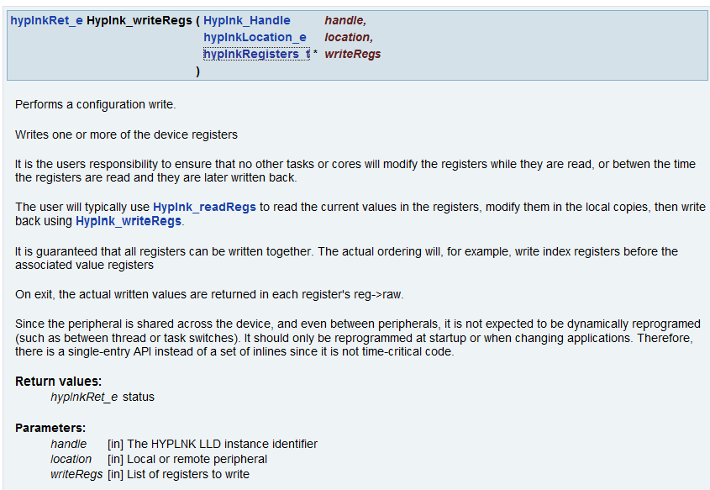
Configuration: HyperLink LLD Example API
Notes:
Configure with LLD functions and CSL functions. You can load the table in one write instead of two writes

Slide 52
Configuration: HyperLink LLD Data Structures
hyplnkChipVerReg_s Specification of the Chip Version Register
hyplnkControlReg_s Specification of the HyperLink Control Register
hyplnkECCErrorsReg_s Specification of the ECC Error Counters Register
hyplnkGenSoftIntReg_s Specification of the HyperLink Generate Soft Interrupt Value Register
hyplnkIntCtrlIdxReg_s Specification of the Interrupt Control Index Register
hyplnkIntCtrlValReg_s Specification of the Interrupt Control Value Register
hyplnkIntPendSetReg_s Specification of the HyperLink Interrupt Pending/Set Register
hyplnkIntPriVecReg_s Specification of the HyperLink Interrupt Priority Vector Status/Clear Register
hyplnkIntPtrIdxReg_s Specification of the Interupt Control Index Register
hyplnkIntPtrValReg_s Specification of the Interrupt Control Value Register
hyplnkIntStatusClrReg_s Specification of the HyperLink Interrupt Status/Clear Register
hyplnkLanePwrMgmtReg_s Specification of the Lane Power Management Control Register
hyplnkLinkStatusReg_s Specification of the Link Status Register
hyplnkRegisters_s Specification all registers
hyplnkRevReg_s Specification of the HyperLink Revision Register
hyplnkRXAddrSelReg_s Specification of the Rx Address Selector Control Register
hyplnkRXPrivIDIdxReg_s Specification of the Rx Address PrivID Index Register
hyplnkRXPrivIDValReg_s Specification of the Rx Address PrivID Value Register
hyplnkRXSegIdxReg_s Specification of the Rx Address Segment Index Register
hyplnkRXSegValReg_s Specification of the Rx Address Segment Value Register
hyplnkSERDESControl1Reg_s Specification of the SerDes Control And Status 1 Register
hyplnkSERDESControl2Reg_s Specification of the SerDes Control And Status 2 Register
hyplnkSERDESControl3Reg_s Specification of the SerDes Control And Status 3 Register
hyplnkSERDESControl4Reg_s Specification of the SerDes Control And Status 4 Register
hyplnkStatusReg_s Specification of the HyperLink Status Register
hyplnkTXAddrOvlyReg_s Specification of the Tx Address Overlay Control Register
Notes:
Very important to look at the structure. Structure tells you what value – look at header file

Slide 53
Agenda
Overview
Address Translation
Configuration
Performance
Example

Slide 54
HyperLink Performance
Silicon Results with 6678
Theoretical bound is 35.56 Gbps
Results are in 31.39 – 34.53 Gbps range
Payload (bytes) | Payload (bits) | No. of Lanes | SRC/DST | AET for Wr | Actual Throughput (Wr) Gbps
4096 | 32768 | 4 | L2/DDR3 | 954 | 34.35
8192 | 65536 | 4 | L2/DDR3 | 2088 | 31.39
16384 | 131072 | 4 | L2/DDR3 | 3975 | 32.97
32768 | 262144 | 4 | L2/DDR3 | 7592 | 34.53
Notes:
54
Talking Points
Theoretical bound – 8b/9b encoding (redundancy to coding, bus width), and other parameters including bus width, cpu
See backup slides to understand why theoretical bound is 35.56 Gbps

Slide 55
Agenda
Overview
Address Translation
Configuration
Performance
Example

Slide 56
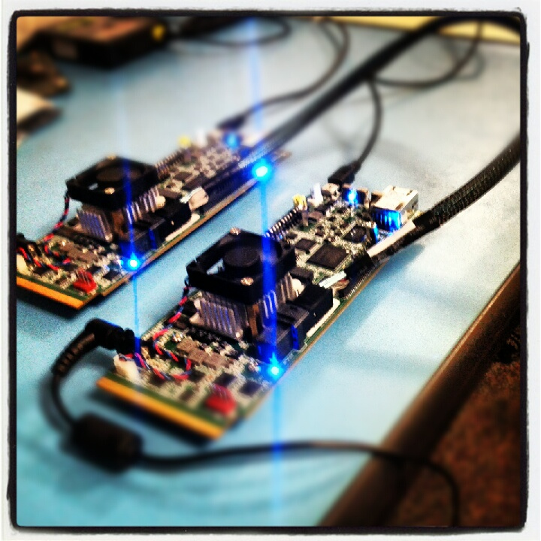
HyperLink Example: Demo
When you install TI’s Multicore Software Development Kit (MCSDK), one of the packages it installs is the Platform Development Kit (PDK)
Path to example: pdk_C6678_x_x_x_xx\packages\ti\drv\exampleProjects\hyplnk_exampleProject
Example can be run in loopback mode on one 6678, or in 6678-to-6678 mode
The mode is defined using a loopback flag in header file hyplnkLLDCfg.h, as:
We will now switch to CCS, to run the example in 6678-to-6678 mode, with two 6678 EVMs interfaced with a HyperLink external cable, as shown in the picture
#define hyplnk_EXAMPLE_LOOPBACK
Notes:
56
Switch to CCS View and run example

Slide 57
HyperLink Example: Leverage Functions
Useful configuration functions part of HyperLink example and can be used “as is” or be modified by users
PDK_INSTALL_PATH\ti\drv\hyplnk\example\common\hyplnkLLDIFace.c
Some of the configuration functions are:
hyplnkRet_e hyplnkExampleAssertReset (int val)
Void hyplnkExampleSerdesCfg (uint32_t rx, uint32_t tx)
hyplnkRet_e hyplnkExampleSysSetup (void)
Void hyplnkExampleEQLaneAnalysis (uint32_t lane, uint32_t status)
hyplnkRet_e hyplnkExamplePeriphSetup (void)
Notes:
Leverage the example to change it as per you need.

Slide 58
References
Keystone HyperLink User Guide http://www.ti.com/lit/SPRUGW8
6678 Data Manual http://www.ti.com/lit/ds/sprs691c/sprs691c.pdf
HyperLink C66x to FPGA http://www.integretek.com/products/Hyperlink.html
For questions regarding topics covered in this training, visit the support forums at the TI E2E Community website

Slide 59
BACKUP SLIDES

Slide 60
HyperLink Performance: Theoretical bound
Theoretical bound calculation on write throughput for HyperLink:
6678 does 8b/9b encoding, therefore
Useful data bandwidth = 50 x 8 / 9 = 44.44 Gbps
16bytes header for every 64bytes of data (max. write burst) Effective max. data write throughput = 44.44 * 64/(64+16)
= 35.56 Gbps
Notes:
60
Hyperbridge Maximum Throughput
The maximum data rates are 12.5*4=50 GBaud input and 12.5*4= 50 GBaud output, simultaneously, and useful data bandwidth is 50*8/9=44.44Gbps. The throughput of Hyperbridge depends on the payload size, transaction type and the memory end point the Hyperbridge access. The bigger the payload, the higher the throughput. In Nyquist/Shannon, the HyperBridge does not support extended control symbol. For each burst of data, it needs 8Bytes for control word and another 8Bytes control word for alignment.
In NySh, the maximum write burst is 64Bytes, even though the EDMA and other master end points are able to generate bigger write burst. But any bigger burst over 64B write burst is fragmented at 64B address boundary. Therefore, the maximum write throughput for vUSR is 44.44Gbps *64/(64+16)=35.56Gbps.
For read performance, it depends on the memory end point the Hyperbridge access. The MSMC SRAM returns the read in 32Bytes per burst, local L2 returns read in 16Bytes per burst, and the DDR_EMIF returns 64Bytes per burst. The HyperBridge returns each read burst individually, therefore, the read from DDR_EMIF can reach 44.44*64/(64+16)= 35.56Gbps, read from MSMC SRAM can reach 44.44* 32/(32+16)=29.63Gbps and read from local L2 can reach 44.44* 32/(16+16)=22.22Gbps.
When vUSR is in the loopback mode, since the read return data and the read commands share the same link, the read performance future degrades. the read from DDR_EMIF can reach 44.44*64/(64+16+16)= 29.63Gbps, read from MSMC SRAM can reach 44.44* 32/(32+16+8) =25.40Gbps and read from local L2 can reach 44.44*32/(16+16+4) 19.75Gbps. The write performance in the loopback mode is same as the normal operation mode.

Slide 61
Overview: TeraNet Connections & Interrupts

Slide 62
Overview: HyperLink Interrupts
Detection - detected an interrupt to the HyperLink local device that was generated either as software interrupt (writing to interrupt register) or as hardware
Forward – generate an interrupt packet and send it to the remote unit
Mapping – receive an interrupt packet from the remote and forward it to the configure location in the local device
Generating – generate an interrupt in the local device

Slide 63
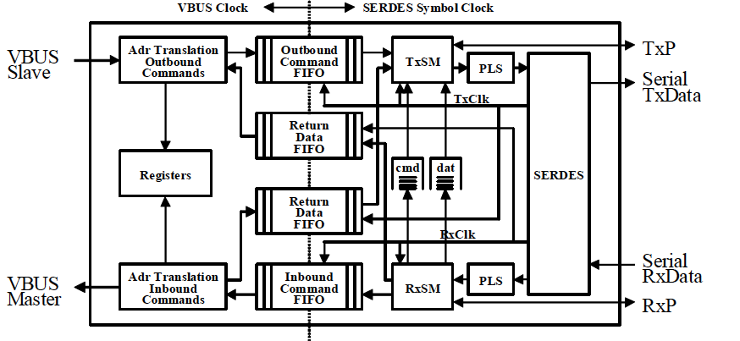
Address Translation: Block Diagram

Slide 64
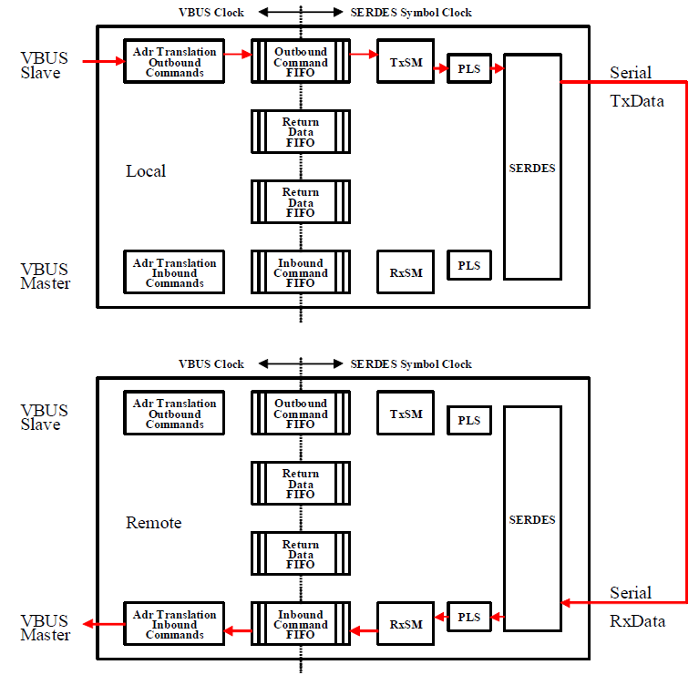
Protocol: Write Operation

Slide 65
Address Translation: Rx Side Example 1
Solution Explained
256MB segment → 28-bit offset → mask = 0x0FFF_FFFF
0x0567 89a0 address
Bits 28-31 → 0b0101 = 5
txigmask = 11 mask 0x0FFF_FFFF
Address sent to the receive/remote side = 0x5567_89a0
On the receive side, the address is
0x8000_0000 + 0x0567_89a0 = 0x8567_89a0

Slide 66
Address Translation: Rx Side Example 2
Solution Explained
8 segments, each segment of size 0x0100_0000 (16M)
Addresses start at 0x8000_0000, 0x8200_0000, 0x8400_0000, to 0x8E00_0000
24 bits offset – 0x067_89a0
Segment number 0101 = 5
Row 5 0x8A00_0000 Size 23 (mask = 0x00ff ffff)
On the receive side,
the address is 0x8A00_0000 + 0x0067_89A0 = 0x8A67_89A0

Slide 67
Address Translation: Rx Side Example 3
Solution Explained
8 segments, 7 each of size 0x0100_0000 (16M)
Addresses start at 0x8000_0000, 0x8100_0000, 0x8200_0000, to 0x8600_0000.
For 8 segments, the maximum size is 32M. That is, 25 bits.
25 bits offset, 3 bits segment number 010 = 2
Row 2 0x8200_0000 Size 23 (mask = 0x00ff ffff)
On the receive side,
the address is 0x8200_0000 + 0x0067_89A0 = 0x8267_89A0

Slide 68
Address Translation: Rx Side Example 4
Solution Explained
9 segments
The first 8 segments are L2 memory of each core (512K = 19 bits).
The 9th segment is the MSMC (4M = 22 bits).
The maximum size is 4M. That is, 22 bits.
6 bits to choose the segment (64 segments)
22 bits offset Segment number 010101 = 21 ????
Row 5 0x1480 0000 Size 18
On the receive side, address is 0x1480 0000 + 0x0007 89a0 = 0x1487 89a0 (L2, Core 4)

Slide 69
HyperLink Example: SerDes Configuration
/*****************************************************************************
* Sets the SERDES configuration registers
****************************************************************************/
void hyplnkExampleSerdesCfg (uint32_t rx, uint32_t tx)
{
CSL_BootCfgUnlockKicker();
CSL_BootCfgSetVUSRRxConfig (0, rx);
CSL_BootCfgSetVUSRRxConfig (1, rx);
CSL_BootCfgSetVUSRRxConfig (2, rx);
CSL_BootCfgSetVUSRRxConfig (3, rx);
CSL_BootCfgSetVUSRTxConfig (0, tx);
CSL_BootCfgSetVUSRTxConfig (1, tx);
CSL_BootCfgSetVUSRTxConfig (2, tx);
CSL_BootCfgSetVUSRTxConfig (3, tx);
} /* hyplnkExampleSerdesCfg */

